Slide 1
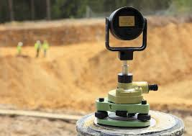
Welcome & Introductions

Slide 2
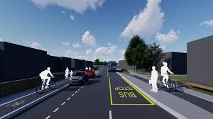
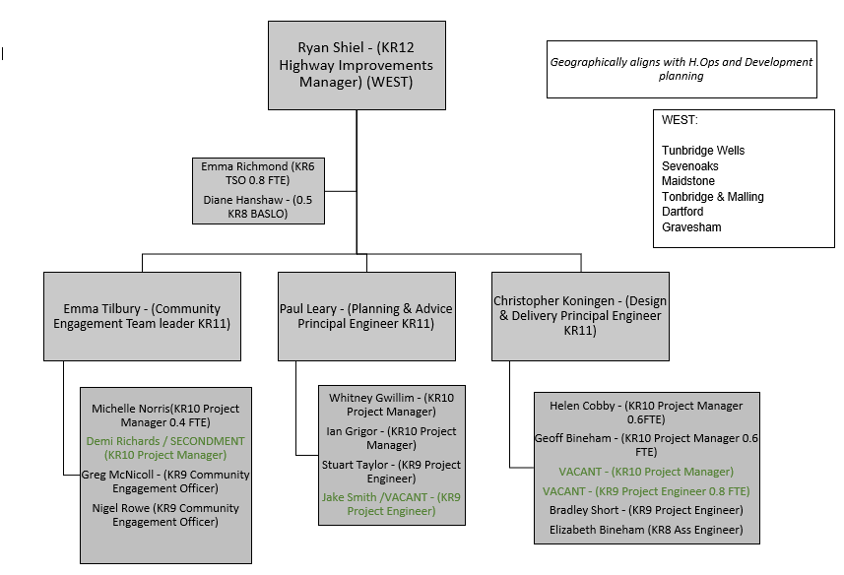
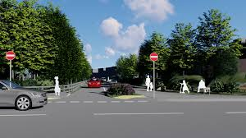
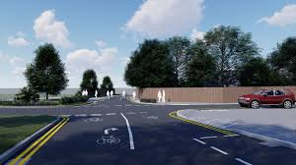
How are we set up to serve you

Slide 3
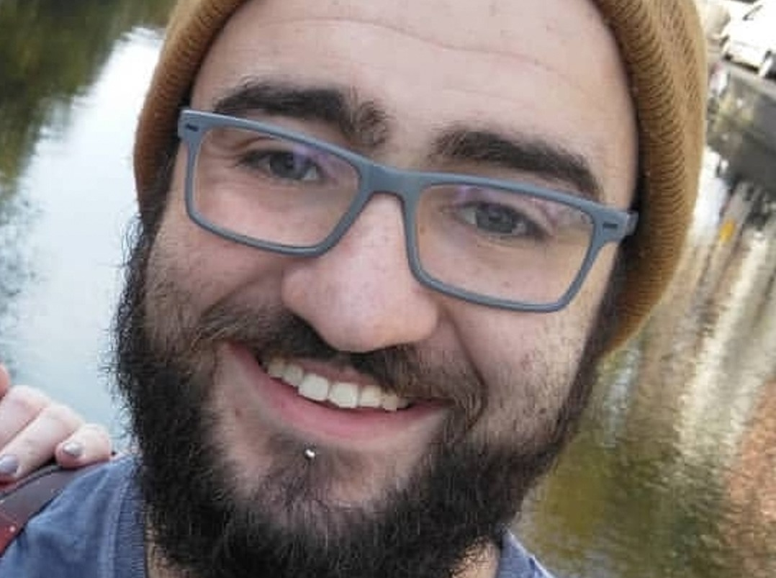
Need to get in touch
Your WEST KENT community & engagement team are here FOR YOU

Slide 5
Financial Constraints for us all
We have limited budget to deliver items on HIP’s just £60,000 per Anum; so we need to use this conservatively across the 6 districts in West Kent.
We won’t be able to pay for works in every parish every year, even on very small schemes. But we can always offer advice and we can assist you if you can fund works should you choose to.

Slide 6
Guidance Note coming soon

Slide 7
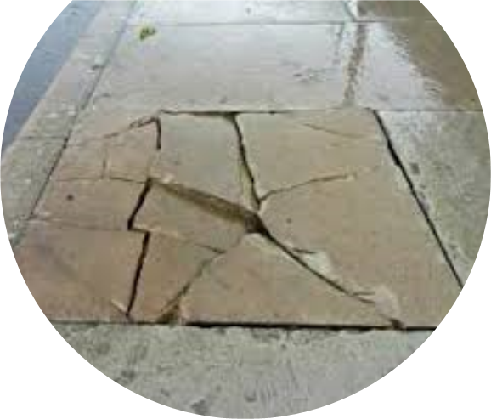
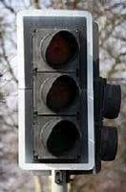
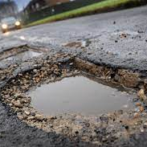
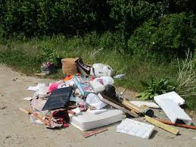
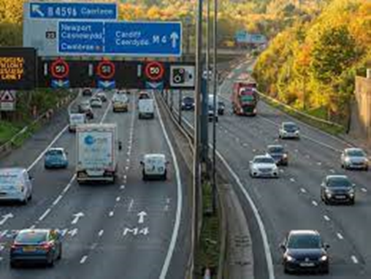
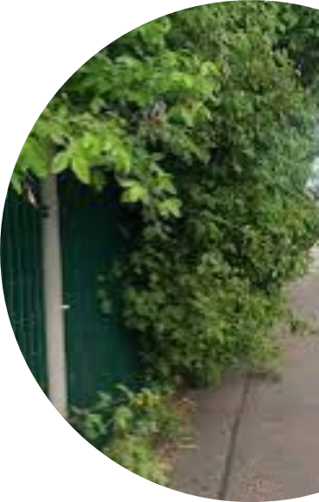
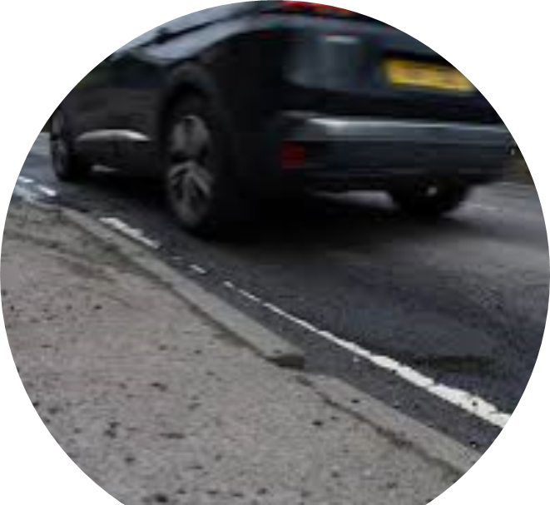
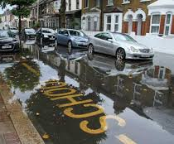
Maintenance issues should NOT be included on your Highway Improvement Plan. Please report maintenance issues via the contact centre (03000 418181) or online via the following link www.Kent.Gov.Uk/roads-and-travel/report-a-problem and not via emails as it may not reach the correct team/person. You need to contact: Your District/Borough Council for bus shelters, fly tipping, litter, parking or street cleaning National Highways (formerly Highways England) for motorways and major A road problems on 0300 123 5000

